Slide 1

Customer Buying Behaviour Prediction
05-06-2024

Slide 2
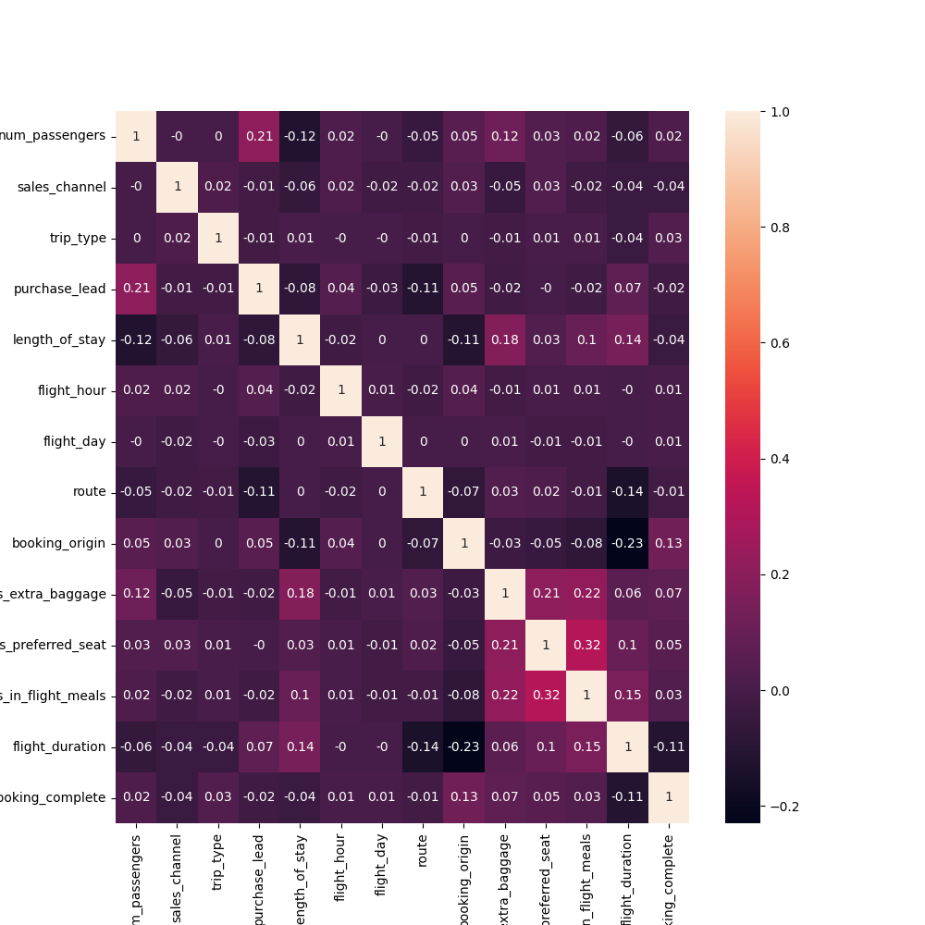
Pearson Correlation
The heatmap illustrates the correlation between various parameters. This correlation provide high dependency on wants extra baggage, wants in flight meals, number of passenger and low dependency on booking origin, route, flight hour.

Slide 3
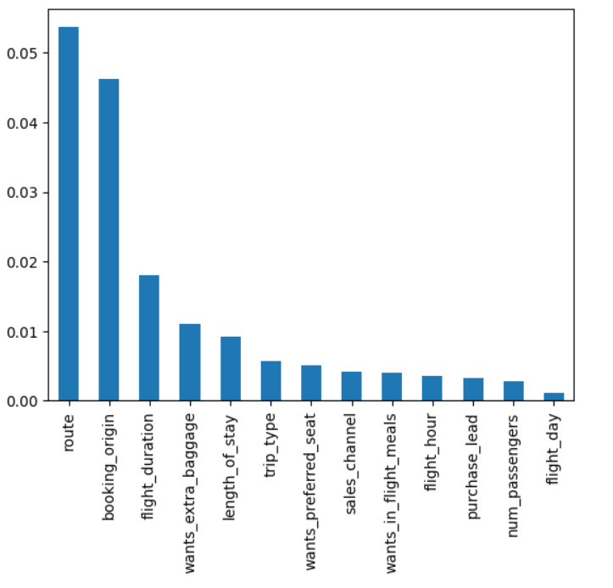
Feature Selection
Balancing the Dataset : The dataset contains a “ booking_complete " column with two classes: 0 (42522 instances) and 1 (7478 instances), indicating a significant imbalance. To handle the imbalance, we employed the SMOTE (Synthetic Minority Over-sampling Technique) method. After applying SMOTE, the dataset had an equal number of instances for both classes (0 and 1).
Feature Selection : We used the mutual_info_classif function to assess the importance of each feature in predicting the “ booking_complete " outcome.
Model Training:Using the balanced dataset and the top 6 selected features, we trained a Random Forest classifier. After training, the model achieved an accuracy of 82.9%.

Slide 4
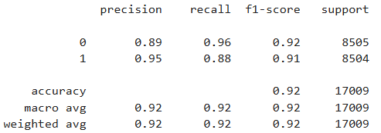
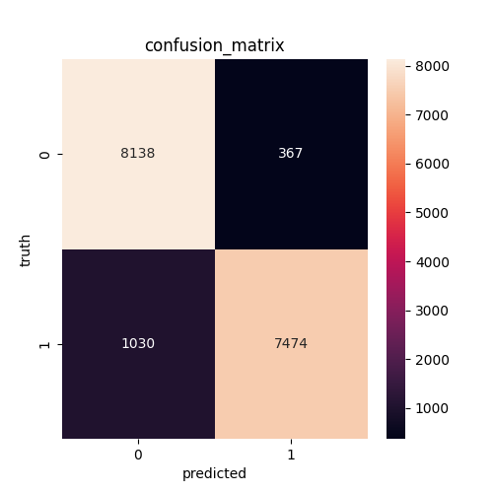
Confusion Matrix
Model Training with Balanced Data : Using the balanced dataset, we trained a Random Forest classifier using all the parameters available in the dataset. The model achieved an accuracy of 91.78% on the test set.

